Slide 1
Project Management Plan
& RMMM
By Luca Irimie, Sebastian Kuka
Paul Murariu, Leia Sayed
(Team 3)

Slide 2
Project Introduction
The VR Wheelchair Ping Pong (VRWPP) project seeks to develop an immersive virtual reality game experience that puts wheelchair users against an AI opponent in a game of ping pong.
Purpose Statement: This project aims to close the gap in VR gaming accessibility and offer players of all skill levels an entertaining and enjoyable experience.
VRWPP is designed as a single-player game in a standard VR gaming environment.
Senior Design 1 GOAL → Tutorial Game Mode Complete
Senior Design 2 GOAL → Player-Versus-AI Competitive Gameplay, 2 Levels of Difficulty

Slide 3
Software Project Management Plan Creation Process
Step 1: List software functionality, potential performance issues, determine behavioral and technical constraints.
Step 2: Create project estimates using COCOMO and Function Points for cost ($ and PM), time (months), and staffing required. Determine sizing type for project (Organic, Semi-detached, Embedded).
Step 3: Highlight and describe potential risks. Include risk table and overview of RMMM Plan.
Step 4: Explain the project scheduling process. Provide layout of task assignment for all members. Provide project timeline for better visualization
Step 5: Describe the team structure and organization, list methods of communication along with frequency of progress reports.
Step 6: Explain the methods employed for progress tracking and quality assurance control.

Slide 4
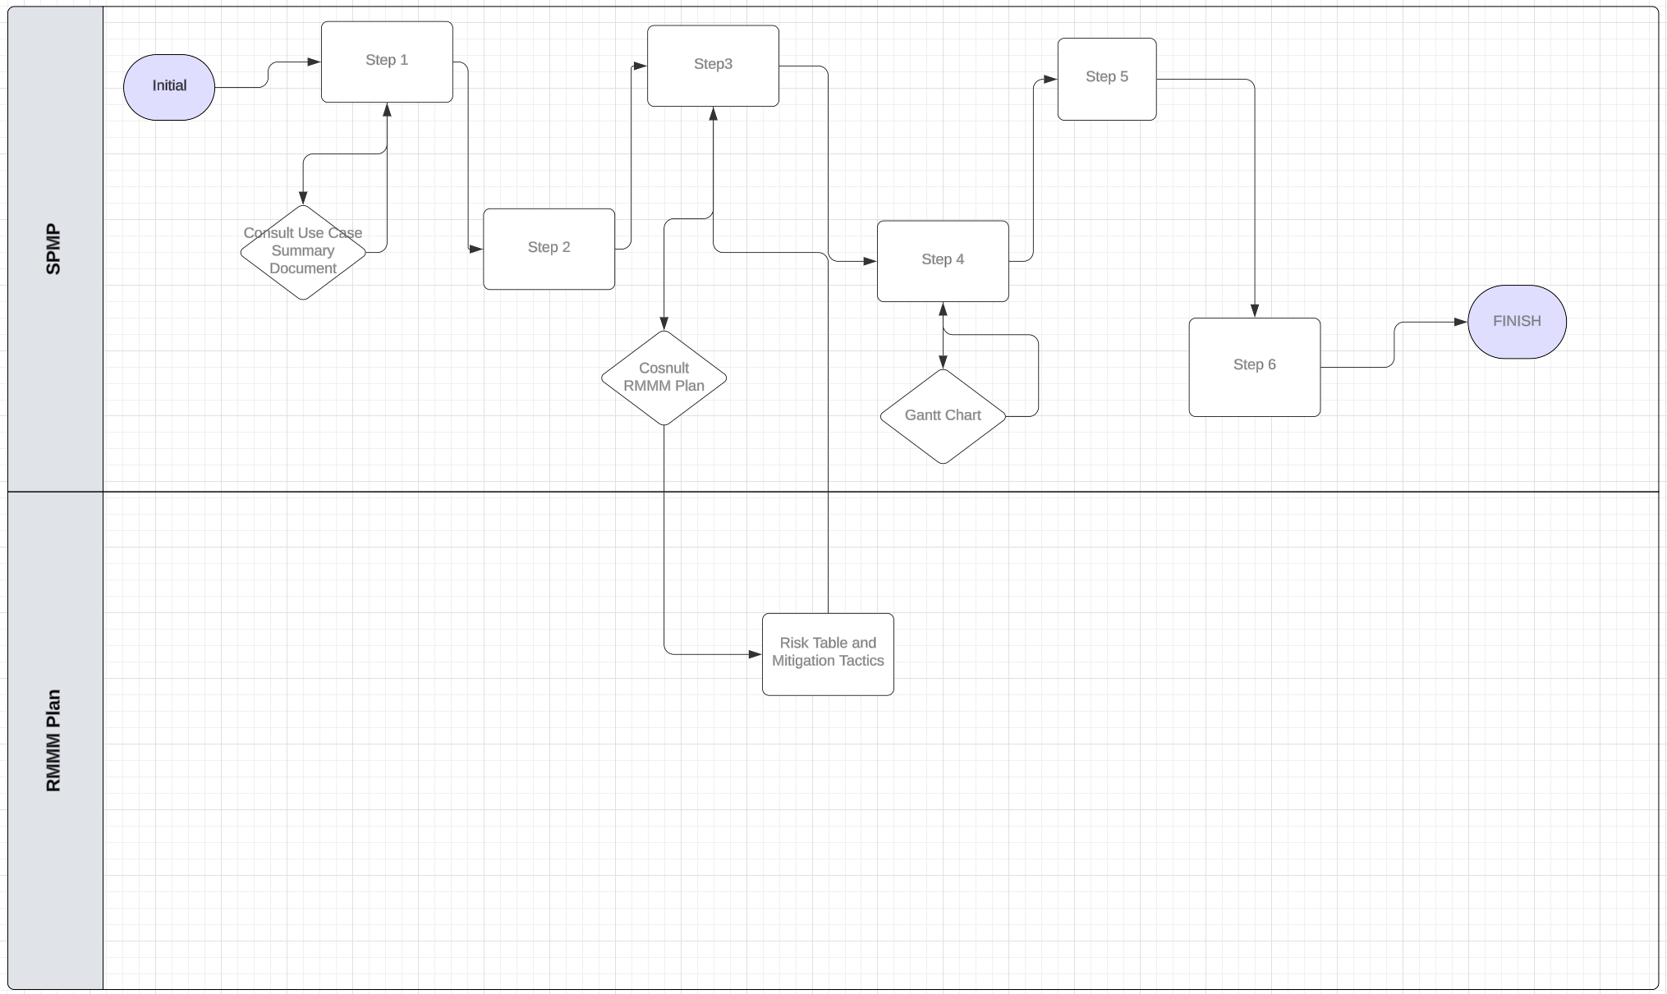
Software Project Management Plan Creation Process - Visual

Slide 5
Software Project Management Plan
Section 1.0 - Introduction
Introduction: virtual reality game experience that puts wheelchair users against an AI opponent in a game of ping pong.
Implement olympic-level rules of play.
1v1 style of play against AI opponent.
Project Scope: End goal is to develop player-versus-AI gameplay with increasingly difficult levels of play.
Store player metrics and information - login credentials, game hours, wins, losses.

Slide 6
Software Project Management Plan
Section 1.0 - Introduction (Continued)
3. Major Software Functions
Player Mechanics:
Striking the ball
Wheelchair swivel
Serving the ball
AI Opponent:
Striking the ball
Wheelchair swivel
Serving the ball
Game Screens:
Main Menu
Pause
Start Game
Login
Player Statistics
Tutorial:
Start-stop instruction on how to play
Interactive dialog boxes
Restart command
Competitive Gameplay:
Scorekeeping
Exchanging service
Prompt to play again after game completion

Slide 7
Software Project Management Plan
Section 1.0 - Introduction (Continued)
Performance/Behavior Issues:
Latent visual response when elements interact with each other.
Makes gameplay difficult to enjoy.
Navigation from screen to screen within the game needs to be smooth and easy-to-use.
Users will be spending a good portion navigating while playing.
Constraints:
Cannot begin final prototype until feasibility prototype is complete
All players must play tutorial mode before starting competitive play against AI opponent.

Slide 8
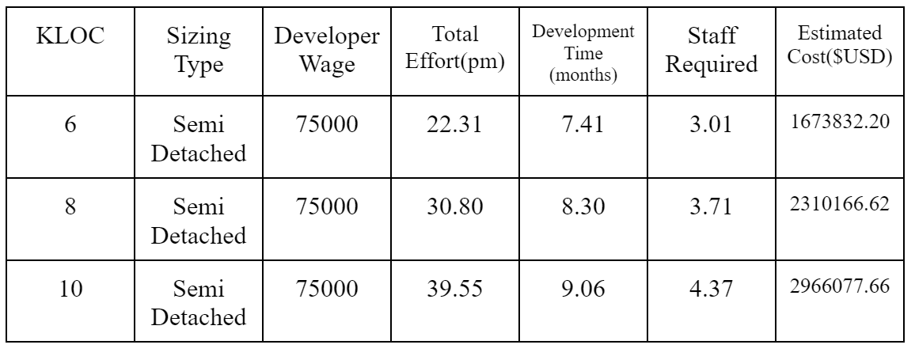
Software Project Management Plan
Section 2.0 - Project Estimates
Basic COCOMO Estimation Table:
Notes:
We used three different estimates for our model—six, eight, and ten thousand lines of code (LOC)—to account for potential wrong assumptions we make about the complexity of our yet-to-be-created software. For our sizing type, we went with “semi-detached” because we are a mix of experienced and inexperienced developers working on a relatively unfamiliar application.

Slide 9
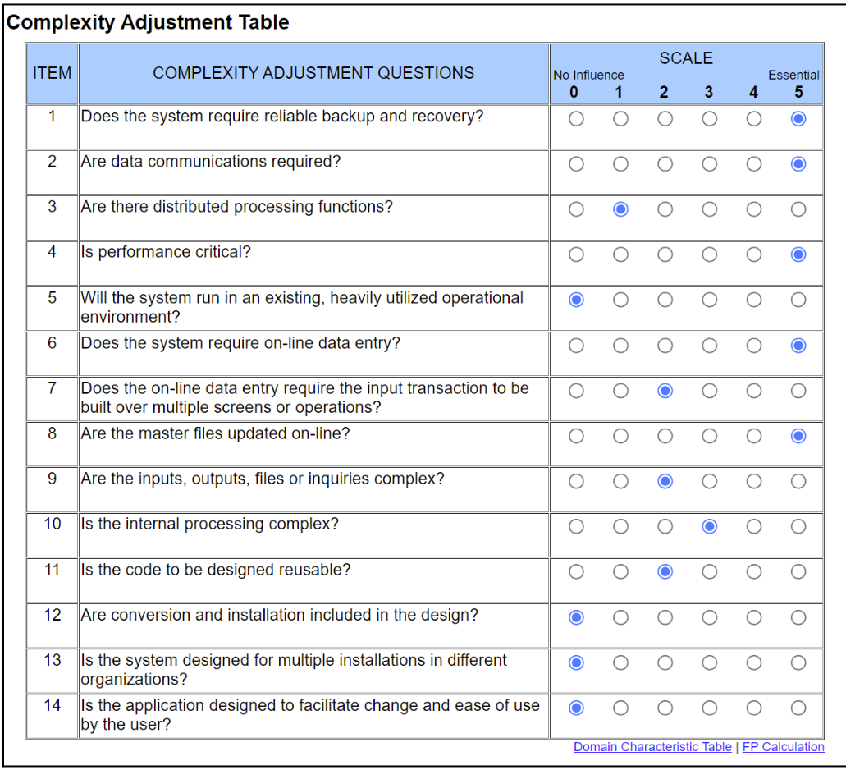
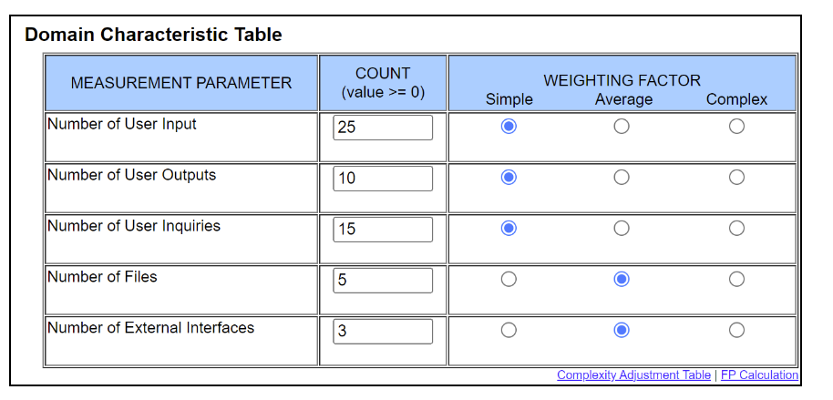
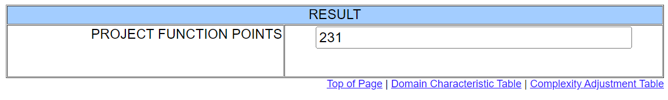
Software Project Management Plan
Section 2.0 - Project Estimates (Continued)
Function Point Estimation Table:
Notes:
We used three different estimates for our model—six, eight, and ten thousand lines of code (LOC)—to account for potential wrong assumptions we make about the complexity of our yet-to-be-created software. For our sizing type, we went with “semi-detached” because we are a mix of experienced and inexperienced developers working on a relatively unfamiliar application.

Slide 10
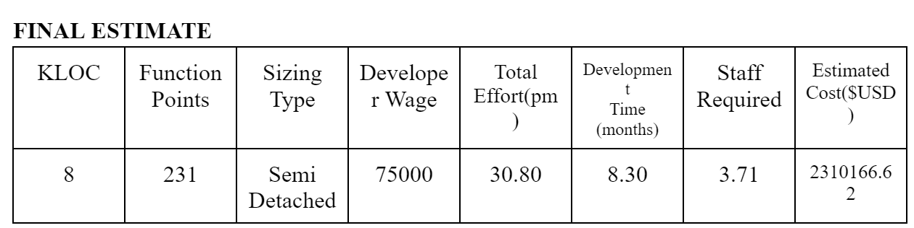
Software Project Management Plan
Section 2.0 - Project Estimates (Continued)
Notes:
We used three different estimates for our model—six, eight, and ten thousand lines of code (LOC)—to account for potential wrong assumptions we make about the complexity of our yet-to-be-created software. For our sizing type, we went with “semi-detached” because we are a mix of experienced and inexperienced developers working on a relatively unfamiliar application.

Slide 11
Software Project Management Plan
Section 3.0 - Risk Management*
Project Risks:
Given that there is VR controller input delay, then player mechanics would be delayed as well, resulting in a poor UX.
Given that there is difficulty in ensuring AI opponent bias, then players will either have too easy or too difficult of an experience.
Given that there is a hardware malfunction during testing, then our progress and efficiency will be slowed down putting us behind schedule.
Given that data retrieval from the database is slow, then the gameflow will be stalled temporarily, creating an aggravating experience.
Given that network issues persist during gameplay, then multiplayer features may be affected.
Given that player accessibility features are not optimized, then users will have a difficult time adjusting to a clunky experience.
*Risk Table shown later
Notes:
We used three different estimates for our model—six, eight, and ten thousand lines of code (LOC)—to account for potential wrong assumptions we make about the complexity of our yet-to-be-created software. For our sizing type, we went with “semi-detached” because we are a mix of experienced and inexperienced developers working on a relatively unfamiliar application.

Slide 12
Software Project Management Plan
Section 4.0 - Project Schedule
Project Task Set:
Process model:
Framework activities include:
Familiarizing with the Unity development environment
Designing game assets for the playing environment, table, ball, paddle, & seating.
The rest of the task set includes:
Implementing movement mechanics for the wheelchair
Establishing hitboxes and player mechanics
Developing the AI opponent behavior
Creating game screens & other UI elements
Preparing and testing the final project
Notes:
We used three different estimates for our model—six, eight, and ten thousand lines of code (LOC)—to account for potential wrong assumptions we make about the complexity of our yet-to-be-created software. For our sizing type, we went with “semi-detached” because we are a mix of experienced and inexperienced developers working on a relatively unfamiliar application.

Slide 13
Software Project Management Plan
Section 5.0 - Staff Organization
Team structure
Bruce Maxim: Client
Luca Irimie
Sebastian Kuka
Paul Murariu(Edward)
Leia Sayed
Progress Reporting:
Daily Basis: WhatsApp
Weekly Meetings: Game Lab (In-Person) or Discord (Virtual)
Bi-Weekly Client Meeting: Game Lab (In-Person)
Emails for document checks and signage between team & client.
Notes:
We used three different estimates for our model—six, eight, and ten thousand lines of code (LOC)—to account for potential wrong assumptions we make about the complexity of our yet-to-be-created software. For our sizing type, we went with “semi-detached” because we are a mix of experienced and inexperienced developers working on a relatively unfamiliar application.

Slide 14
RMMM Risk Table

Slide 15
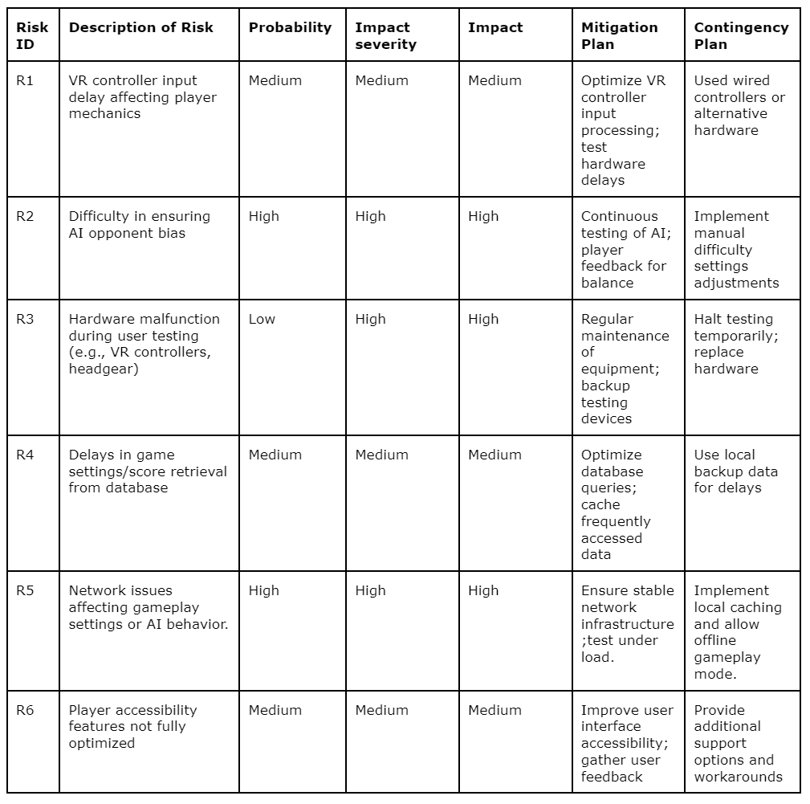
VRWPP - Risk Table
R1: VR controller input delay affecting player mechanics
Description:
Delays in the response time of the VR controller can cause lag between the player’s actions (e.g., moving the wheelchair or swinging the paddle) and the corresponding in-game reaction. This lag can significantly affect gameplay, leading to frustration and poor user experience.
Subconditions:
Inconsistent hardware performance or driver issues.
High latency in communication between the VR controller and the game.
Delays in processing input events within the game software.

Slide 16
VRWPP - Risk Table
R1: Risk Mitigation
Optimize the VR controllers input processing by testing various hardware configurations and fine-tune controller sensitivity.
Conduct multiple hardware tests to detect and resolve any latency issues that the hardware might have with the game.

Slide 17
VRWPP - Risk Table
R1: Risk Monitoring
Monitor latency through internal testing and review input logs for responsiveness patterns.

Slide 18
VRWPP - Risk Table
R1: Risk Management
If delays occur, switch to wired controllers or alternative hardware configurations, and explore additional optimizations.

Slide 19
VRWPP - Risk Table
R2: Difficulty in ensuring AI opponent bias
Description:
It will be challenging to ensure that the AI opponent behaves in a way that is balanced for players of varying skill levels. If the AI is too easy or too difficult, it can either bore or frustrate players, leading to a detachment from playing the game.
Subconditions:
AI behaves unpredictably based on environmental conditions.
AI logic doesn’t scale properly with difficulty settings.
Player feedback is insufficient to calibrate AI bias effectively.

Slide 20
VRWPP - Risk Table
R2: Risk Mitigation
Repeatedly test AI behavior based on player feedback and fine-tune the difficulty logic/opponent bias.
Players will then have manual control to adjust AI difficulty for a balanced playing experience.

Slide 21
VRWPP - Risk Table
R2: Risk Monitoring
Compare game outcomes with preset difficulty levels and adjust AI behavior based on test results.

Slide 22
VRWPP - Risk Table
R2: Risk Management
Implement a manual difficulty adjustment feature if AI balance issues arise.

Slide 23
VRWPP - Risk Table
R3: Hardware malfunction during user testing (e.g., VR controllers, headgear)
Description:
VR hardware, such as controllers or headsets, may malfunction during testing. This could cause disruptions in the development process and lead to delays in feedback from user testing.
Subconditions:
VR headsets may overheat or lose tracking ability.
Controllers may suffer from battery issues or connectivity problems.
Physical damage to hardware during user testing (e.g., drops or collisions).

Slide 24
VRWPP - Risk Table
R3: Risk Mitigation
Regular maintenance checks and backup testing devices will be prepared to prevent hardware related problems.
Testing protocols will ensure safe handling of equipment to minimize damage to the program.

Slide 25
VRWPP - Risk Table
R3: Risk Monitoring
Perform regular hardware inspections and maintain performance logs to detect issues early

Slide 26
VRWPP - Risk Table
R3: Risk Management
Temporarily halt testing in the event of hardware malfunctions and promptly replace or repair faulty equipment.
Backup devices will minimize disruptions.

Slide 27
VRWPP - Risk Table
R4: Delays in game settings/score retrieval from the database
Description:
The game retrieves essential information like settings, scores, and other data from a database. Delays in this retrieval process could affect gameplay, causing interruptions or inconsistencies in game state updates.
Subconditions:
Database queries are slow due to poor optimization.
Network issues affecting the connection between the game and the database.
High load on the database server due to multiple players accessing the system at the same time.

Slide 28
VRWPP - Risk Table
R4: Risk Mitigation
Optimize database queries and introduce caching for frequently accessed data to minimize server overload and reduce delays during gameplay.

Slide 29
VRWPP - Risk Table
R4: Risk Monitoring
Assess database response times during testing and review logs for any signs of poor performance.

Slide 30
VRWPP - Risk Table
R4: Risk Management
Use local backup data during delays and refine database queries and caching strategies.

Slide 31
VRWPP - Risk Table
R5: Network issues affecting gameplay settings or AI behavior
Description:
Although there is no multiplayer support, network issues can still impact the game's real-time communication with a remote database, such as delays in retrieving player settings, updating scores, or syncing AI behavior. These delays can affect the smooth operation of the game, leading to an inconsistent or unresponsive AI opponent.
Subconditions:
Network latency leading to delays in retrieving or updating player progress.
Timeout issues affecting AI decision-making based on player actions.
Poor network performance causing lag in syncing real-time game data (e.g., updating scores).

Slide 32
VRWPP - Risk Table
R5: Risk Mitigation
Establish stable network infrastructure/WiFi connection and tested under different loads of the game.
If network issues continue to occur, an offline mode and local caching will serve as a contingency.

Slide 33
VRWPP - Risk Table
R5: Risk Monitoring
Conduct stability tests under varying network conditions to identify communication delays.

Slide 34
VRWPP - Risk Table
R5: Risk Management
Activate offline mode and local caching to maintain game functionality during network disruptions.

Slide 35
VRWPP - Risk Table
R6: Player accessibility features not fully optimized
Description:
Accessibility features designed to assist players with disabilities may not be fully optimized, leading to difficulties for certain users to enjoy or interact with the game.
Subconditions:
UI elements may not be adequately scaled or customizable.
Lack of sufficient options for various disabilities.
Limited support for alternative control schemes (e.g., adaptive controllers).

Slide 36
VRWPP - Risk Table
R6: Risk Mitigation
Optimize accessibility by offering customizable options and continuously test features with user feedback to ensure a smooth experience for all players.

Slide 37
VRWPP - Risk Table
R6: Risk Monitoring
Test accessibility features to ensure customization options and alternative controls are functioning properly.

Slide 38
VRWPP - Risk Table
R6: Risk Management
Provide support options and workarounds for affected users, and deploy quick fixes for critical accessibility issues.

Slide 39
Risk Mitigation, Monitoring and Management Plan
Section 4.0 - Special Conditions
4.1 Hardware Issues
Extended testing or use of multiple assets could cause VR headsets to overheat or controllers to malfunction.
Testing will be paused, and malfunctioning equipment will be promptly replaced or repaired.
Backup devices will be maintained to minimize disruptions.

Slide 40
Risk Mitigation, Monitoring and Management Plan
Section 4.0 - Special Conditions
4.2 Network Instability
Persistent network issues can disrupt real-time data retrieval and game operations.
If problems arise, the game will switch to offline mode using locally cached data to maintain smooth gameplay.
Network optimizations will be carried out during off-peak hours to improve performance.

Slide 41
Risk Mitigation, Monitoring and Management Plan
Section 4.0 - Special Conditions
4.3 Accessibility Concerns
If accessibility features are not fully functional or optimized, appropriate fixes will be prioritized.
Additional resources will be allocated to address these issues promptly.
The goal is to ensure that all players enjoy an inclusive and accessible gaming experience.

Slide 42
Thank You For Listening!

